Slide 1
The Effects of Color on Gendered Perceptions of a Product

Slide 2
Statement of the Problem
The purpose of our study is to see if differences in color will have an effect on purchase likelihood, attractiveness ratings of a product, as well as other evaluating factors.
We assessed both males and females to try and find a gender difference in ratings scores
We want to tackle the idea that males will also choose the color pink given correct circumstances, based on prior research, and to challenge social norms

Slide 3
Statement of the Problem: Color Defined
Theory was first proposed by Thomas Young and Hermann von Helmholtz in 1850
This theory states that we see based on the three light sensitive cone types we have in our retinas, and this vision is on a spectrum that consists of the three colors: red; green; and blue
The three light sensitive cones are split into short wavelength, medium wavelength, and long wavelength cones, which corresponds to the colors blue, green, and red respectively
Theory was first proposed by Ewald Hering in 1878 and later expanded on by Richard Solomon in 1980
Theory states that color perception is based on activity of opposing color systems. The three systems are listed as green and red, white and black, and lastly yellow and blue, as well as an achromatic black and white
The interaction between the inhibitory and excitatory connections between the three types of cones is how we perceive colors that are not correspondent to a specific cone, such as yellow
Trichromatic Theory
Opponent Process Theory
(Ware, 2008)
Chroma: the purity, or intensity of a color, or distinctive hue of color

Slide 4
Background Research #1
In research done by Silver, McCulley, and Chambliss in 1988, they gathered a group of 582 undergraduate college students to conduct a survey. In the survey they asked questions about participants favorite color in order to see if there was a difference in color preference by gender or by race. Blue was most often chosen as favorite color by both sexes.
This was valuable in our development of the research design, and subsequent hypotheses, because we wanted to test whether or not sex had a role in color preference.

Slide 5
Background Research #2
A study on the brightness of colors looked into participants evaluation of different colors. Participants were prompted with various pictures and were asked to rate attractiveness of stimulus models. It was found that males reported preference for brighter vivid colors and females preferred soft colors. (Radeloff, 1990)
This pertained to us because we wanted to manipulate a graphic in a manner that preference was determinant on only color type. Given that there was an inherent preference for bright and soft colors across sexes, we chose to have three stimuli that incorporate a bright, neutral, and soft color ( Pink, White, Blue respectively).

Slide 6
Background Research #3
Research conducted by Mehta and Zhu in 2009 was done in order to gain more knowledge on how color choice affects emotion and dictates decision making performance. In order to reduce confounds they manipulated only hue. They included white as a neutral stimulus to ensure a non-conflicting stimuli was used. They found that the color red will induce primarily an avoidance motivation, whereas blue will activate an approach motivation
We used this to generate hypothesis that people will shy away from our hue (pink) which closely resembles red. We also modeled our color choice of white for our neutral stimulus after this study

Slide 7
Back ground research #4
In a study by Madden, Hewett and Roth in 2000, it was found that color ranks among the top three considerations, along with price and quality, in the purchase of an automobile. They found that particular colors elicit certain values that buyers look for.
This gave us rationale to test our dependent measure of durability with both products but especially the car. Quality and color associations were also inferred from the research.

Slide 8
Background research # 5
It was found that bright colors may be valued from an aesthetic point of view but may diminish the impression of quality (i.e., functional value). Aesthetic responses are primarily emotional or feeling responses, and as such they are very personal (Creusen & Schoormans, 2004)
This research assisted us in deciding how our products may be valued based on appearance. Bright colors (in our case pink) was hypothesized to be valued less in both value and durability.

Slide 9
Hypothesis #1
Rationale
Hypothesis
There is an innate preference for colors by gender (Radeloff, 1990)
When tested men chose red and blue more frequently. Women showed a preference for yellow, purple, black, and less frequent colors more often than men (Silver, McCulley, Chambliss 1988)
Females will be more likely to purchase the pink product as compared to males

Slide 10
Hypothesis #2
Rationale
Hypothesis
Males tend to prefer stronger chromas as compared to females (Plater, 1967).
Visually, and technically, speaking blue is a more pure color than pink, meaning that its chroma is stronger.
Females tend to prefer off colors (Silver, McCulley, and Chambliss 1988), as such will have a higher aesthetic response to pink (Creusen & Schoorman, 2004)
Males will find the pink products less attractive than females will

Slide 11
Hypothesis #3
Rationale
Hypothesis
Blue is often associated with wealth, trust and security (Madden, Hewett, Ross 2000)
Durability scores are associated with preference or attractiveness of a product. Blue is often associated with wealth, trust and security, while pink is not.
Males will find the pink products less durable as compared to females

Slide 12
Hypothesis #4
Rationale
Hypothesis
Bright colors may be valued aesthetically, but these same colors may give consumers the idea that the product is of low quality. (Creusen & Schoormans 2004)
There is an innate preference for colors by gender (Radeloff, 1990)
Females will be more likely to use the pink products as compared to males

Slide 13
Methods: Subjects
Participants:
n = 188
Males = 71 Females = 117
Mean age = 40.22
Ethnicity
White – 142
Black/African American – 2
Hispanic/Latino – 22
American Indian/Alaskan Native - 2
Asian – 12
Native Hawaiian/Pacific Islander – 1
Other - 6

Slide 14
Methods: Design
Color of Product
 | Blue |  | White |  | Pink
 | P1 | P2 | P1 | P2 | P1 | P2
Males | n = 22 |  | n = 24 |  | n = 25
Females | n = 42 |  | n = 30 |  | n = 45
Sex
Independent Variables:
Gender of the participant
Color of product presented
Dependent Variables:
Likelihood to purchase
Attractiveness rating
Durability rating
Evaluation of product

Slide 15
Methods: Materials
Experimental Graphics
Graphics were manipulated solely for the color of the product and to remove and branding on the
products
Hues of the colors were chosen to resemble the traditional concept of blue and pink as closely
as possible
Blue was chosen as the soft color, while pink was the bright color
White was the neutral variable
Branding was removed to eliminate bias
Products were chosen in an attempt to remain as gender neutral as possible

Slide 16
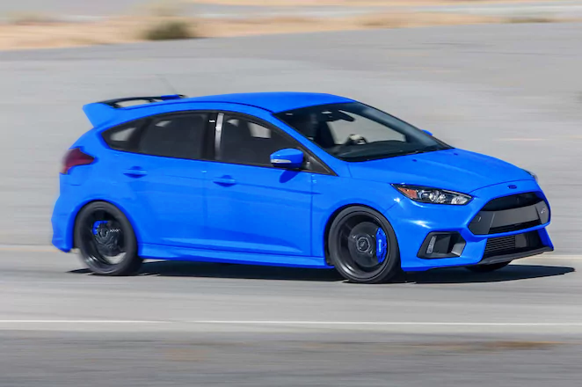
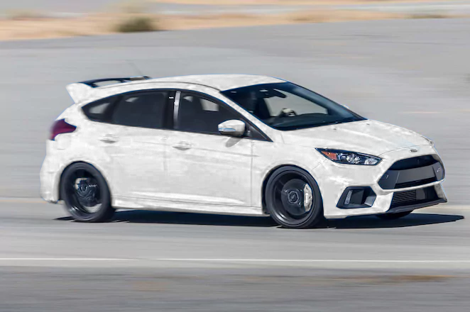
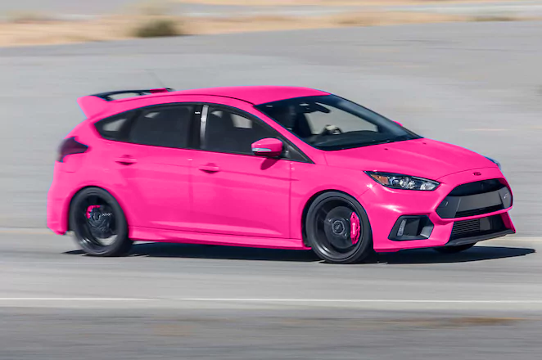
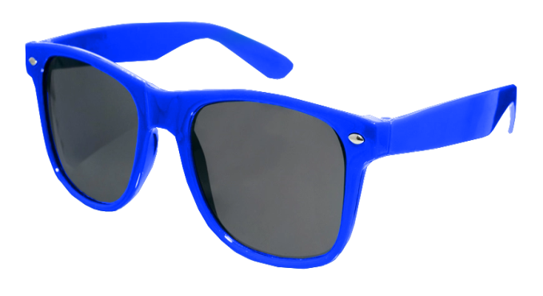
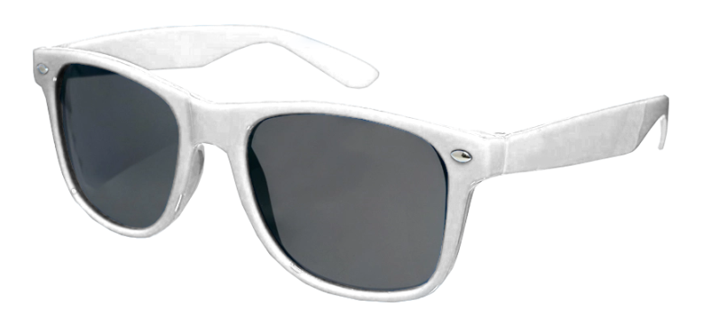
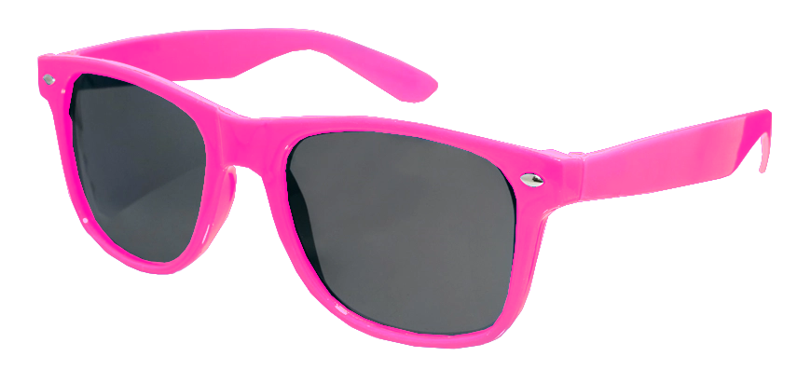
Methods: Sample Images

Slide 17
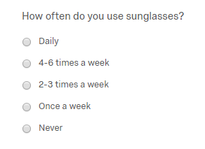
Methods: Materials
Questionnaires
Demographic
Prompting Questions
Descriptive Questions
How old are you?
What is your gender?
What ethnicity do you identify
as?

Slide 18
Methods: Procedures
Procedural sequence was defined by the following steps:
Step 1: After being given an anonymous link to the survey and opening it, participants were randomly assigned via a
consent question that corresponded to one of the color variables. (All consent questions were identical)
Step 2: After consenting to the survey, the participants were asked about their demographics (age, sex, ethnicity, etc.)
Step 3: Following the demographics was a prompting survey that asked about various products, which included
backpacks, cellphones, cars, and sunglasses.
Step 4: When finished with the prompting survey, the participants were shown an image of one of the manipulated
graphic along with a questionnaire
Step 5: Once the participants were done with the first image and set of questions, they were shown the other
manipulated image that was not shown first, along with another questionnaire
Step 6: Once completed with the second image, participants were done with the survey and thanked for their time.

Slide 19
Methods: Data Source/Tests Used
Data Source: Data were entered into SPSS to determine the differences between each sex and their responses and evaluations regarding the different colors of the products
The dependent/descriptive variables were tested using independent samples t-tests and
ANOVA (for H1)
Selected only pink cases
Demographics were calculated through cell frequencies
No tests were run on the prompting questions

Slide 20
Results
Hypothesis #1: Females will be more likely to purchase the pink product as compared to males
Results were found to be not significant, but a trend is apparent between product type and gender, which is interesting nonetheless.
Slider Scale Values
 | Sunglasses |  | Cars
Male | M = 13.30 | SD = 22.80 | M = 21.09 | SD = 31.72
Female | M = 25.37 | SD = 27.72 | M = 15.09 | SD = 26.94
F(2,66) = .08, Mserr = 951.46, p = .924

Slide 21
Results
Hypothesis #2: Males will find the pink products less attractive than females will
Hypothesis was supported, but only partially. Again a trend is apparent between product and gender.
Slider Scale Value
 | Sunglasses |  | Cars
Male | M = 14.17 | SD = 24.59 | M = 30.58 | SD = 35.34
Female | M = 31.81 | SD = 24.76 | M = 23.98 | SD = 28.60
t(66) = -2.765, p = .007

Slide 22
Results
Hypothesis #3: Males will find the pink products less durable as compared to females
Hypothesis was supported, but only partially yet again. Trend of product bias is less apparent.
Slider Scale Value
 | Sunglasses |  | Cars
Male | M = 23.22 | SD = 26.56 | M = 46.63 | SD = 30.87
Female | M = 37.93 | SD = 25.44 | M = 45.40 | SD = 22.60
t(66) = -2.205, p =.031

Slide 23
Results
Hypothesis #4: Females will be more likely to use the pink products as compared to males
Hypothesis was supported, but only partially. The product bias trend is most apparent, while the car remains fairly neutral in judgment values.
Slider Scale Value
 | Sunglasses |  | Cars
Male | M = 14.83 | SD = 25.49 | M = 45.63 | SD = 44.21
Female | M = 44.79 | SD = 33.99 | M = 47.35 | SD = 36.38
t(66) = -3.703, p = .000

Slide 24
Discussion: Limitations
Gender Distribution
Participant size was large enough for statistical analysis, but distribution of males and females was not perfect (more females than males) a larger participant size, or evenly distributed genders, would be ideal
Product Bias
There seemed to have been a bias in the items we chose so we could have chosen more items, or different products all together, to eliminate any bias
Variety of Research
Not much research has been done on color, so it was difficult to develop hypotheses and create a base for the study

Slide 25
Discussion: Future Research
List more available products for rating
Attain a more concisely distributed age range
Utilize more “bright/soft” colors
Attain evenly distributed gender amongst participants
Increase variability and work towards eliminating any product bias
Color pool was very limited for our study
An even distribution would represent a more accurate data set regarding the comparison of gender
Our age range was from 18-86 years of age

Slide 26
References
Creusen, M. E., & Schoormans, J. P. (2004, December 22). The Different Roles of Product Appearance in Consumer Choice*. 22(1), 63-81. https://onlinelibrary.wiley.com/doi/full/10.1111/j.0737-6782.2005.00103.x
Grossman, R. P., & Wisenblit, J. Z. (1999). What we know about consumers’ color choices. Journal of Marketing Practice: Applied Marketing Science, 5(3), 78-88. doi:10.1108/eum000000000456
Madden, T. J., Hewett, K., & Roth, M. S. (2000). Managing images in different cultures: A cross-national study of color meanings and preferences. Journal of International Marketing, 8(4), 90-107. Retrieved from http://mantis.csuchico.edu/login?url=https://search.proquest.com/docview/197575478?accountid=10346
Mehta, R., & Zhu, R. (2009, February 27). Blue or Red? Exploring the Effect of Color on Cognitive Task Performances. http://science.sciencemag.org/content/323/5918/1226.full
Radeloff, D. J. (1990). Role of Color in Perception of Attractiveness. Perceptual and Motor Skills, 71(1), 151-160. doi:10.2466/pms.1990.71.1.151
Silver, N. Clayton, et al. (1988). Sex and racial differences in color and number preferences. Perceptual and Motor Skills, 66 (1), 295–299., doi:10.2466/pms.1988.66.1.295.
Ware, Colin. (2008). Visual Thinking: For Design. Ergonomics. 53. -256.

